Slide 1

L-SYSTEM USING PROCESSING
DEEPTHI SUDHARSAN
(CB.EN.U4AIE19022)

Slide 2



FEATURES OF THE TOPIC
INTRODUCTION
L SYSTEM EXAMPLE CODES AND EXPLANATION
APPLICATIONS

Slide 3
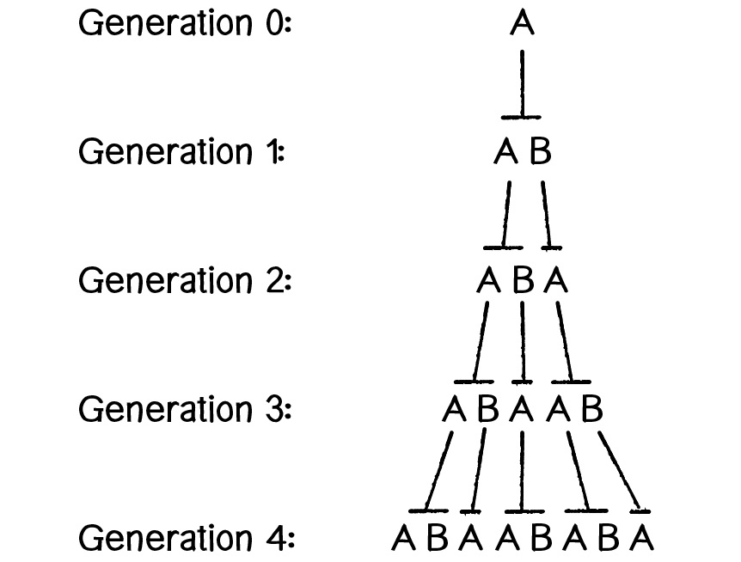



INTRODUCTION
An L - System is a parallel string rewriting system. A string rewriting system consists of an initial string, called the seed/axiom, and a set of rules for specifying how the symbols in a string are rewritten as (replaced by) strings.
Here, A is the seed or axiom.
Rules are,
A ->AB
B ->A

Slide 4





OBJECTIVE OF THE PROJECT
To create L systems using Processing software and UI

Slide 5
L SYSTEM EXAMPLE 1
Axiom : F
Rules: F -> FF+[+F-F-F]-[-F+F+F]
Initialization and importing of Packages:
Here, we are importing the packages that we require for the UI (User Interface) and plotting the L – system.
The variable lastString is to store the current string and given as input to generate the next string.
cwidth and cheight are the dimensions of the canvas where the L-system is going to be plotted.
Current is the initial point or coordinates (here, on the x axis, at cwidth/2 location).
currDir is the direction it is facing at the moment.
deltaAngle is the rotation angle in radians.
linelen is the length of the line drawn (set to 200 in the beginning).

Slide 6
generate Function:
A dictionary with the rules for the L-system is created. The size of line is made smaller in every iteration. The current coordinates and direction are re initialized to begin from the same place.
If the laststring is not empty, using a for loop, we split the string into individual substrings and based on the rules, we append the result to the nextstring. If the substring doesn’t match any rule, the substring itself gets appended.
Else if laststring is empty that means we haven’t begun yet or the laststring hasn’t been set to the axiom, so we set nextSentence and laststring to the axiom.

Slide 7
rotatedLine and drawPaths Function:
rotatedLine function is used to set the change in the coordinates of the new point with respect to the origin.
drawPaths function
Using a for loop, we split the string into individual substrings. Using switch case, we check if the substring is equal to either of the following and perform the appropriate command,
F, (then we move forward), “+” (rotate anticlockwise), “-” (rotate clockwise), “[” ( push into stack),“]” (pop from the stack), else we print, “Unimplemented command”. Then we return current or the current coordinates.

Slide 8
setup Function:
The main purpose of the setup() function is to create a UI to allow user to generate each iteration of the L-system with the press of the button and generate the L-system plot simultaneously.
This function creates the pop up canvas and output string along with the generate button. Every time the generate button is clicked, the string is rewritten and the plot is updated.

Slide 9
OUTPUT

Slide 10
L SYSTEM EXAMPLE 2
Axiom : F-F-F-F
Rules: F -> F[F]-F+F[--F]+F-F

Slide 13
OUTPUT

Slide 14
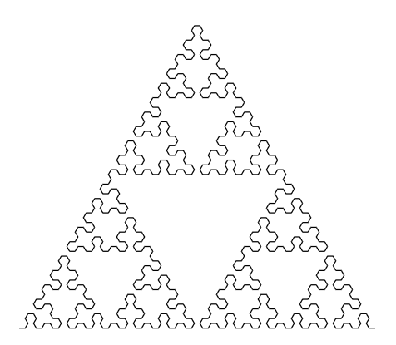
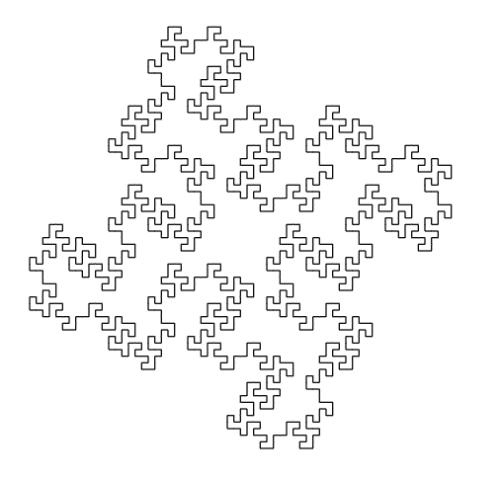
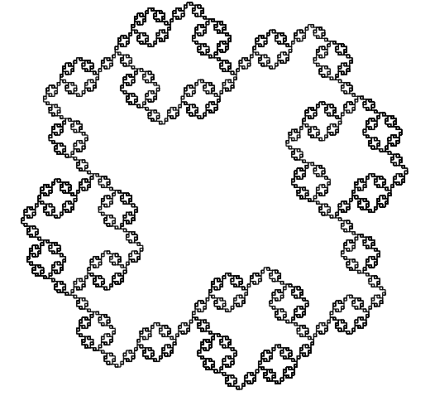

By changing and playing with the values, rules, axioms and angles, we can make different L systems. For example, the same code as the first example has been modified for second example by giving a different axiom and set of rules and the deltaAngle to get the new L system.
AXIOM : F-F-F-F
RULES : F->F+FF-FF-F-F+F+FF-F-F+F+FF+FF-F
AXIOM : F-F-F-F
RULES : F->FF-F-F-F-F-F+F
AXIOM : B
RULES : A->B+A+B,B->A-B-A

Slide 15

APPLICATIONS
To model the development of simple multicellular organisms (for example, algae) in terms of division, growth, and death of individual cells and to describe the behaviour of plant cells.
2. In Textile Industry to create new patterns and designs.
3. In architecture, for designing and for generating architectural plans.
4. Used to carry out many mathematical computations like calculating factorial, summing series etc.
5. Writing musical compositions and playing it on a microcomputer
6. Cryptology (for coding and encoding secret messages)

